Slide 1
The ethics of data visualization
Megan Ozeran, University of Illinois
Visualizing the Future, August 2019
Notes:
I know a variety of projects touch on some ethical principles in data visualization and I’m definitely interested to see how we can combine our efforts and create excellent instruction around them. But I was looking at the ethics of data visualization broadly, and trying to identify what those principles should be.
If you had a chance to read my position statement, you may see the themes across that here, but this is going to be a bit different. A colleague pointed out that the way I was talking about ethics in the position statement was more of a guiding document, the kind of thing that helps you make ethical decisions. What I’m going to present here is the higher level – what are the ethical principles we should follow? And I have some visuals that I hope will help show what I mean – sometimes negatively, sometimes positively.

Slide 2
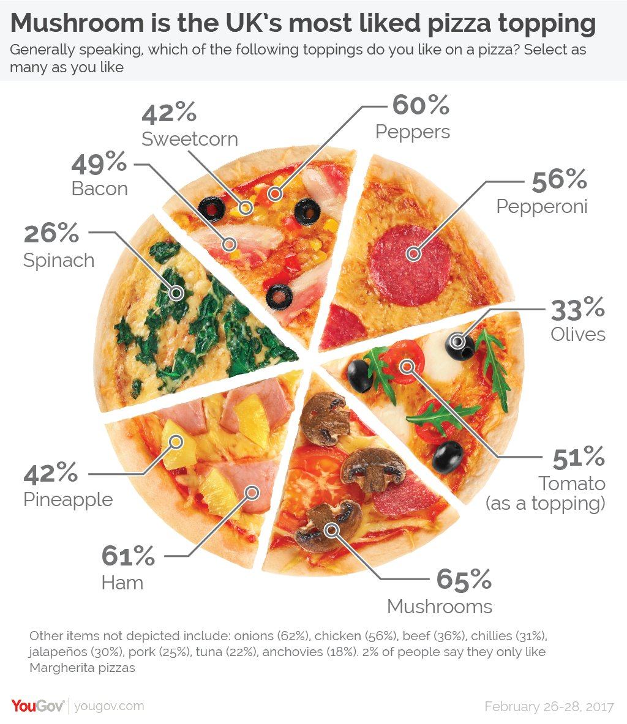
Image 1
Notes:
Be accurate.
This wasn’t even intentionally misleading, but it caused a whole lot of upset.

Slide 3
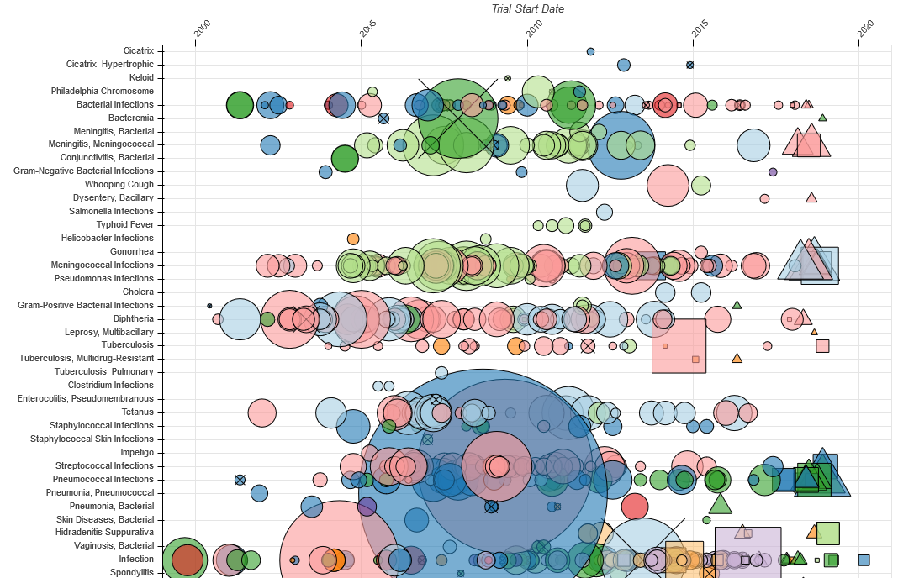
A Bird’s Eye View of Pharmaceutical Research and Development – Aero Data Lab
Image 2
Notes:
Make visualizations understandable to the broadest audience possible.
From JunkCharts: “We faced a number of hurdles in understanding this chart as there is so much going on. … It would help to have a legend explaining the sizes, shapes and colors. These were explained within the text. … The vertical axis presents another challenge. It shows the disease conditions being investigated. As a lay-person, I cannot comprehend the logic of the order. With over 800 conditions, it became impossible to find a particular condition. The search function on my browser skipped over the entire graphic.”
Make visualizations accessible to as many types of people with varying abilities as possible. [small text, possible color blindness issues, text not actually text!]

Slide 4
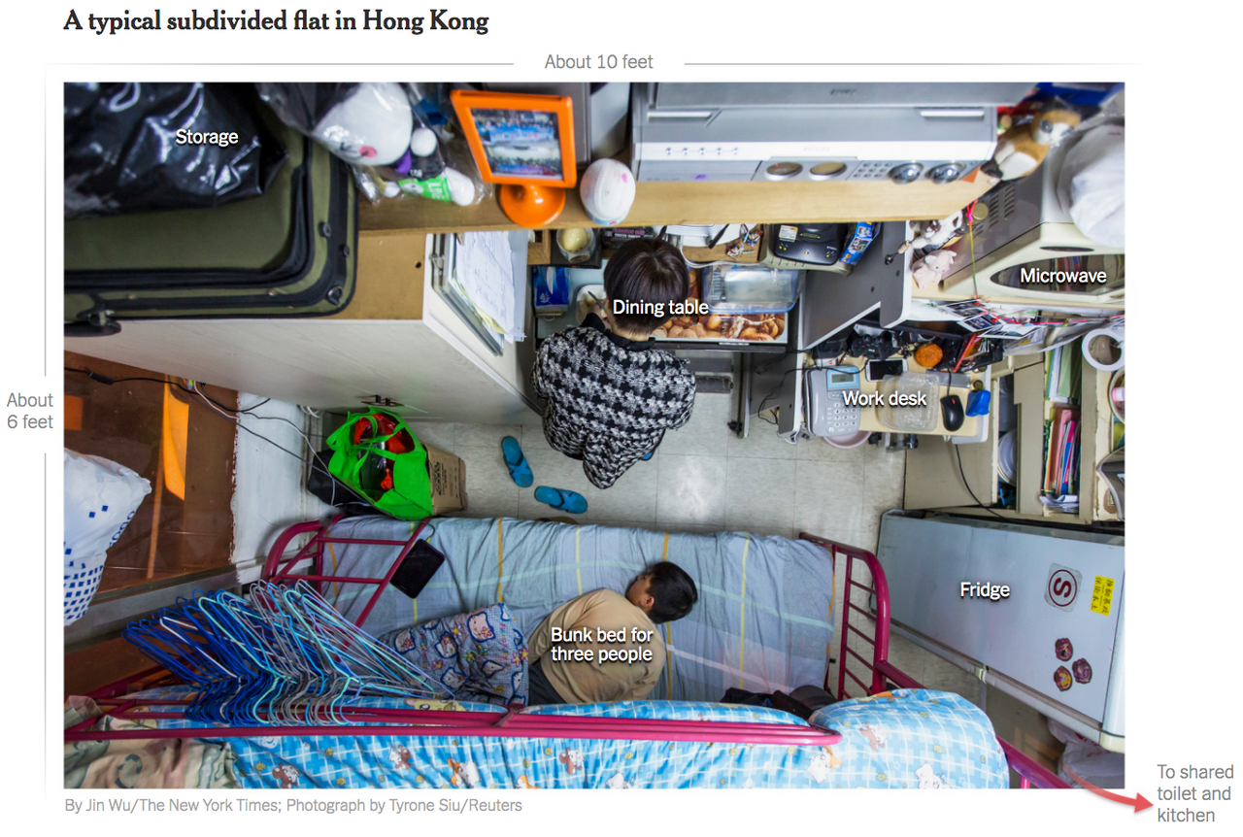
Image 3
Notes:
Honor the people whose bodies and labor made your visualizations possible.
For once, a positive example of the ethical principle at stake. It’s humanizing the situation rather than taking the people out. This may be called “photovisualization,” specifically, but it’s still a great example.

Slide 5
“mapmaking through which
millions were repeatedly killed”
(Denis Wood)
Wood, D., (2010), Everything sings: Maps for a narrative atlas, Los Angeles, CA: Siglio Press, p. 13.
Notes:
Don’t create visualizations you know will be used to harm others.
These words are from the cartographer Denis Wood. For some context, university-trained mapmakers were helping the U.S. Armed Forces bomb Vietnam.

Slide 6
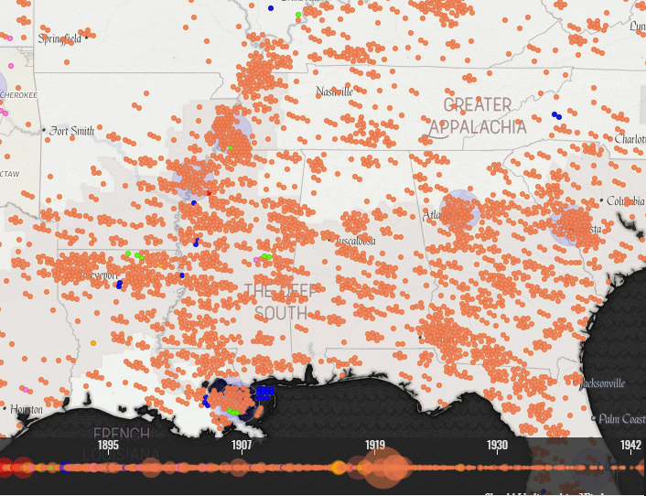
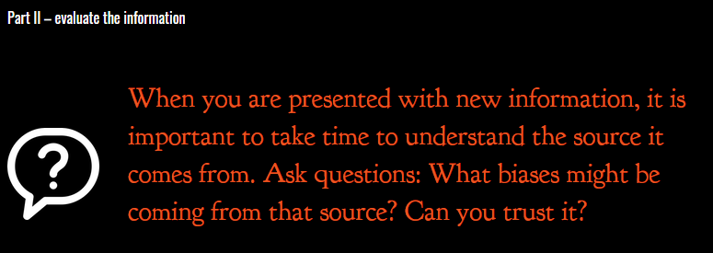
“Map of White Supremacy mob violence”
by auut studio
Image 4
Notes:
Be clear about your subjectivity and attempts to mitigate your biases.
Make your decisions transparent, both for reproducibility and so that a conversation about truth is possible.
They explain the sources of the data they used, questions to ask about those sources and the analysis, caveats to their mapping.

Slide 7
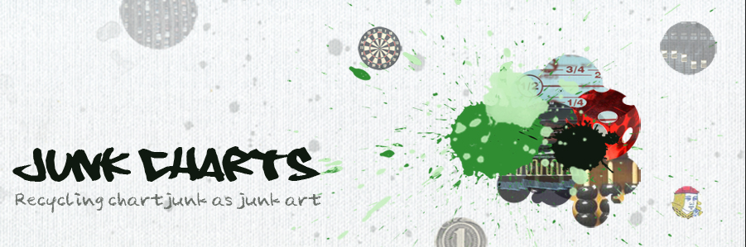
“Kaiser Fung's blog. Recycling chartjunk as junk art. Data visualization criticism.”
Image 5
Notes:
Be open to feedback and constructive criticism.
…hopefully before your chart shows up on this blog.

Slide 8
In sum:
Be accurate.
Make visualizations understandable to the broadest audience possible.
Make visualizations accessible to as many types of people with varying abilities as possible.
Honor the people whose bodies and labor made your visualizations possible.
Don’t create visualizations you know will be used to harm others.
Be clear about your subjectivity and attempts to mitigate your biases.
Make your decisions transparent, both for reproducibility and so that a conversation about truth is possible.
Be open to feedback and constructive criticism.
Notes:
In sum…

Slide 9
Image sources
@YouGov, “Mushroom is the UK’s most liked pizza topping”, https://twitter.com/YouGov/status/838720989991223297
Aero Data Lab, “A Bird’s Eye View of Pharmaceutical Research and Development”, https://www.aerodatalab.org/birds-eye-view-of-research-landscape
Jin Wu and Tyrone Siu, “A typical subdivided flat in Hong Kong”, in “Tiny Apartments and Punishing Work Hours: The Economic Roots of Hong Kong’s Protests”, New York Times, https://www.nytimes.com/interactive/2019/07/22/world/asia/hong-kong-housing-inequality.html
auut studio, “Map of White Supremacy mob violence”, on MonroeWorkToday, http://www.monroeworktoday.org/explore
Kaiser Fung, header image for Junk Charts, https://junkcharts.typepad.com/junk_charts/

